Slide 1


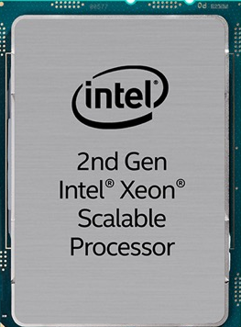
Data Analysis Approaches For ExaScale
A Conversation
Powered by
Jim Jeffers
Sr. Principal Engineer and Sr. Director
Advanced Rendering and Visualization Team
Intel Corporation
@jamesljeffers ; james.l.Jeffers@intel.com
Dr. Paul Navrátil,
Director of Visualization
Texas Advanced Computing Center, UT Austin.
@panavratil; Paul Navratil <pnav@tacc.utexas.edu>
Thanos from Avengers Infinity War
Rendered by V-Ray (with Intel® Embree)
Courtesy of Digital Domain and Marvel Studios
1

Slide 2


Intel® Embree Ray Tracing Kernel Library
Open Source, High Performance, Feature Rich
How to Train Your Dragon: The Hidden World
Scene rendered by MoonRay (with Intel® Embree):
Property of DreamWorks Animation

Slide 3
Moana Island Scene* Rendered with Intel® OSPRay, Embree, Open Image Denoise
*Public Dataset courtesy of Walt Disney Animation Studios
JIM!!!! These ”Pics” are Cool… Even Impressive… I’ve seen these movies!
WHAT THE $%$^ DO THEY HAVE TO DO WITH HPC?!!?

Slide 4
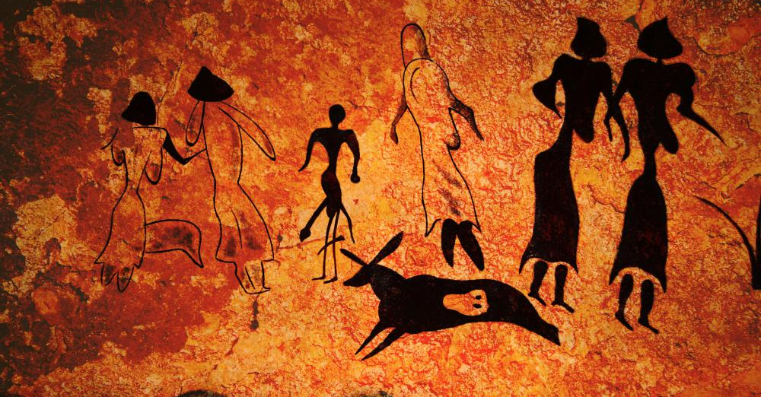
Visualization is Foundational to Insight
Roughly 30% of the human brain is devoted to vision.
Visualization is the dominant way of acquiring information.
Visualization makes complex data comprehensible and meaningful.

Slide 5
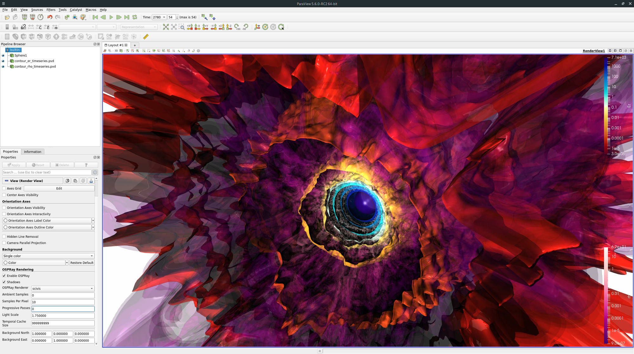
… AND BETTER IMAGEs LEAD TO BETTER, MORE ACCURATE science INSIGHTS!
Intel® OSPRay: Scalable, Portable, Distributed Rendering API
Dataset: 7000+ Timesteps, >7TB of data
SIGGRAPH19 Live Demo: Every 4nd Time Step, ~2TB, ~3200 steps
9 Nodes 2x Intel Xeon Scalable 8260 with Optane DC DIMMs
Interactive, >20 fps
Stellar Radiation: Visualization by Greg P Johnson, Intel, and Joseph Insley Argonne Nat’l Lab using OSPRay. Simulation provided the University of California, Santa Barbara, team lead, Lars Bildsten.
5

Slide 6
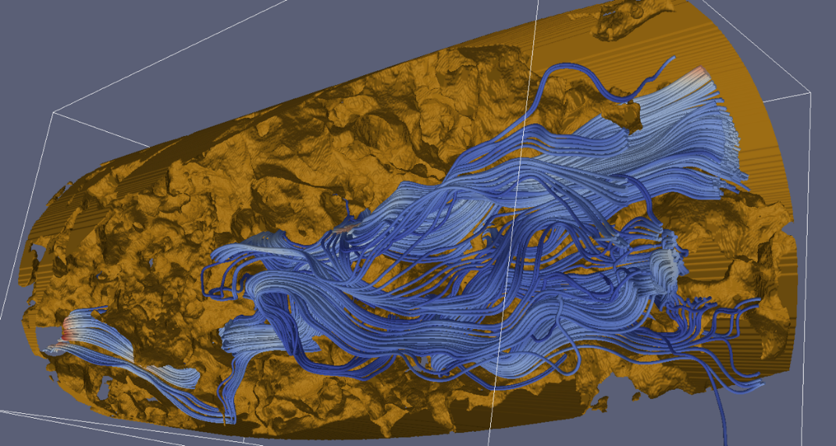
'Traditional’ Visualization (Rasterization)

Slide 7
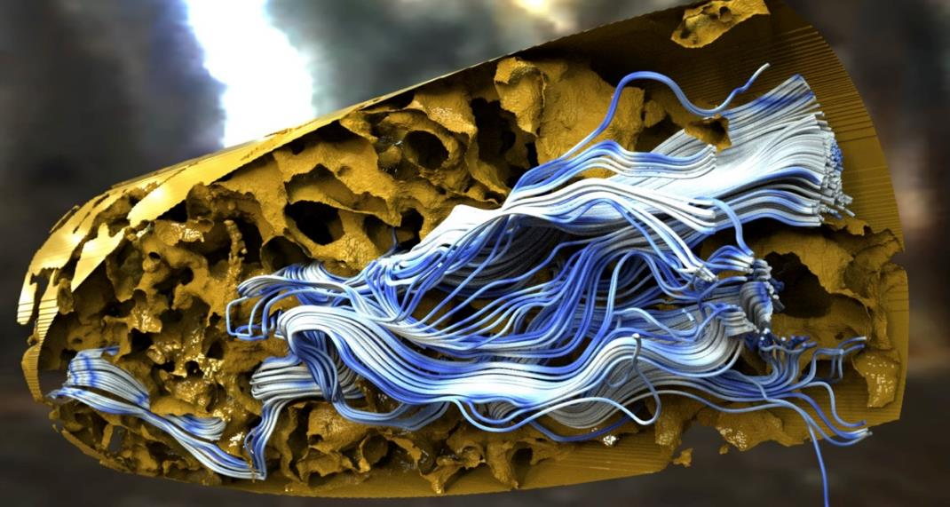

Modern, more effective visualization [Ray Tracing]
Ray Tracing based visualization (OSPRay)

Slide 8
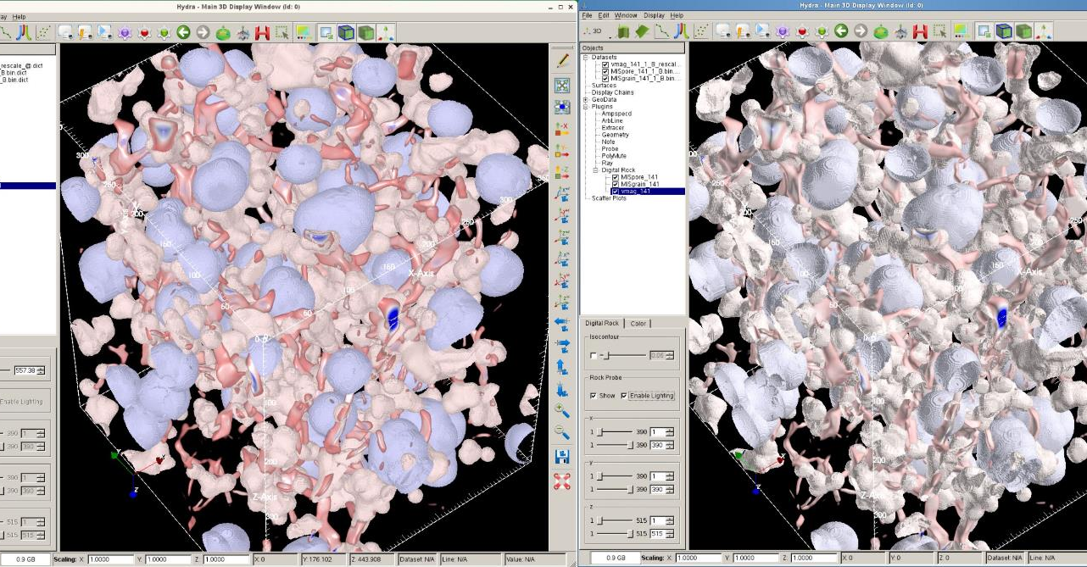
“”Oil and Water” Data and images courtesy Jim Lin, BP Inc.
Notes:
Approve side by side (Rasterization Left) (Ray tracing right) exact same input. Look closely, you can see the “concave” nature of the data on the right using ray tracing/global illumination, but would have no clue about that feature when rasterized. This is a classic example of how SciVis / Oil and Gas benefits from ray tracing. By the Way this is “Surface Rendering” not Volume rendering in this case.

Slide 9
Over the last 5 years…..
Ray Tracing -
[the method used make the most compelling animated movies and special effects]
- has become HPC’s vis method of choice
e.g., for the last 4 SuperComputing Conferences…. between 4, 5, and 6 out of 6 SuperComputing Visualization showcase finalists have used OSPRay and/or Embree Ray Tracing technology…… And every 1st place award has been to a Ray Traced solution.

Slide 10
Challenges AT EXASCALE
The “Requirement” for ’In Situ’ Visualization

Slide 11
In Situ [same machine] Visualization – Why?
File Size | 1000 GBps | 100 GBps | 10 GBps | 1 GBps
1 TB | 1 sec | ~ 10 sec | ~ 2 min | ~ 17 min
1 PB | ~ 17 min | ~ 3 hours | ~ 1 day | 12 days
1 XB | 12 days | 124 days | 3 ½ years | 34 years
Increasingly Difficult to Write Data from Simulation to Disk

Slide 12
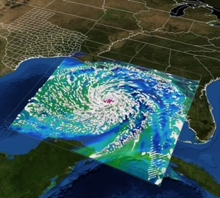
In Situ Visualization – Why?
High-frequency writes
???
Low-frequency writes
In Some Cases…. Lack of In Situ - Instant Analysis .. Could cost lives!

Slide 13
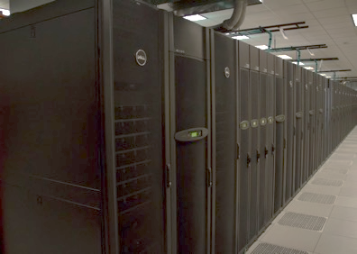
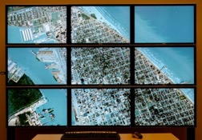
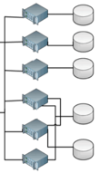
In Situ Visualization Workflow
Compute and Vis Shared Circ. Buffer Holds ‘many’ timesteps
[e.g. 10,000 steps @ 10GB/step = 10 PBytes ]
Simulation
Visualization Algorithms
Images
In-Situ API
API supports:
Zero-copy,
rate control;
Animation;
Instant or deferred analysis
Rendering
Parameters
Initial Conditions
Geometry
Display
PFS
α
β
γ
01001101011001
11001010010101
00101010100110
11101101011011
00110010111010

Slide 14
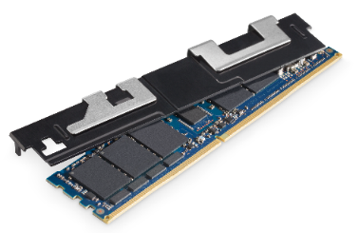
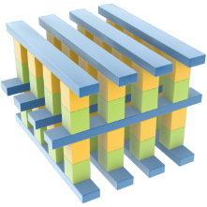
THE exascale IN SITU “GAME CHANGER”… Intel® Optane™ DC Persistent Memory
DRAM attributes
Nand ssd attributes
Performance comparable to DRAM at low latencies¹
Data persistence with higher capacity than DRAM²
Optane™ Media
“Fast performance comparable to DRAM” - Intel persistent memory is expected to perform at latencies near DDR4 DRAM. Benchmarks and proof points forthcoming. “low latencies” - Data transferred across the memory bus causes latencies to be orders of magnitude lower when compared to transferring data across PCIe or I/O bus’ to NAND/Hard Disk. Benchmarks and proof points forthcoming.
Intel persistent memory offers 3 different capacities – 128GB, 256GB, 512GB. Individual DIMMs of DDR4 DRAM max out at 256GB.
Notes:
TAKEAWAY: The latest Intel innovation extends Intel® Optane™ media by placing it onto a DIMM, combining great features found in both DRAM and NAND SSDs.
This innovative new solution, will move larger amount of data closer to the CPU, so it can be accessed, processed, and analyzed in real-time (without first being retrieved from storage). Our product will be performant, and comparable to DDR4 DRAM at low latencies. Additionally, we will have higher capacity and data persistence features typically found in NAND SSDs. This means that customers can keep more data, closer to the CPU for faster processing, and that data will remain in memory when the system is power cycled.
Additional color on why persistent memory for Q+A? - This is the game changer for memory technology. Persistent memory technologies allow development of products with the attributes of both storage and memory. The products are persistent, like storage, meaning they hold their content across power cycles, and they are byte-addressable, like memory, meaning programs can access data structures in-place. This allows for memory like performance with the storage and capacity benefits of NAND.
______________________________________________________________________________________________________________________________________________________
Footnotes:
1. “Fast performance comparable to DRAM” - Intel persistent memory is expected to perform at latencies near DDR4 DRAM. Benchmarks and proof points forthcoming. “low latencies” - Because data will be transferred across the memory bus, latencies will be orders of magnitude lower when compared to transferring data across PCIe or I/O bus’ to NAND/Hard Disk. Benchmarks and proof points forthcoming.
2. Intel persistent memory offers 3 different capacities – 128GB, 256GB, 512GB. Individual DIMMs of DDR4 DRAM max out at 128GB (with 256GB ramping beginning 2018).

Slide 15
INTEL® OPTANE DC Persistent Memory IN ACTION!
Intel® OSPRay: Scalable, Portable, Distributed Rendering API
Dataset: 7000+ Timesteps, >7TB of data
SIGGRAPH19 Live Demo: Every 4nd Time Step, ~2TB, ~3200 steps
9 Nodes 2x Intel Xeon Scalable 8260 with Optane DC DIMMs
Interactive, >20 fps
Stellar Radiation: Visualization by Greg P Johnson, Intel, and Joseph Insley Argonne Nat’l Lab using OSPRay. Simulation provided the University of California, Santa Barbara, team lead, Lars Bildsten.
15

Slide 16
Have no Fear! In Situ is ‘here’!
Your Friends in the Vis Community and more recently the compute/physics community have been working and preparing to fully enable the workflow. You can use it today – and it will continue to get better tomorrow!
“JOIN US!”

Slide 17
In Situ Terminology Project (courtesy Ken Moreland, Sandia)
Integration
Type
Proximity
Access
Division of
Execution
Operation
Controls
Output
Type
Bespoke
Same
Memory
Direct
Shallow
Copy
Time
Division
Automatic
Adaptive
Subset
Dedicated
API
On-node
Distinct
Memory
Automatic
Non-
adaptive
Transform
Direct
Deep
Copy
Multi-
purpose
API
Off-node
Same
Computing
Resource
Human-in-
the-loop
Blocking
Derived
Fixed
Inter-
position
Human-in-
the-loop
Non-
blocking
Distinct
Computing
Resource
Space
Division
Derived
Proportional
Inspection
Indirect

Slide 18
Example In Situ Options courtesy Hank Childs and In Situ Terminology Group
VTK-Based APIs
  ParaView Catalyst – https://www.paraview.org/in-situ/
  VisIt LibSim - https://www.visitusers.org/index.php?title=Libsim_Batch
  LLNL ALPINE - https://github.com/Alpine-DAV/alpine
I/O API
  ADIOS - https://www.olcf.ornl.gov/center-projects/adios/
Meta API
  Sensei - http://www.sensei-insitu.org/
  Damaris - http://damaris.gforge.inria.fr/doku.php
Ensemble Post-Process
  Cinema - http://cinemaviewer.org/
Leverage These Software Solutions on Frontera!

Slide 19
Architectural Vision for
ExaScale Visualization
Current and near-future machines include many-core processors (typically 50 – 100’s of CPU cores per node)
Each core contains wide vector units:
use them for max utilization (e.g., *-AVX512)
Fortunately the existing visualization stack is optimized for such processors!
Use your preferred rendering method
independent of the underlying hardware
  Performant rasterization
  Performant ray tracing
  Visualization and analysis on the simulation machine
Work Begun on Stampede1, Fully-Adopted on Stampede2
and continues on Frontera!

Slide 20
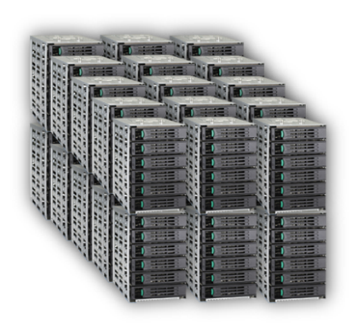



The In Situ Vis Analysis Advantage
General Purpose Hardware and Open Software
High Fidelity
Work with larger data sets – not constrained by GPU memory
Continuously improving state-of-the-art algorithms
Excellent Performance
Less data movement, I/O
Invest power, space, budget in greater compute capability
Dynamically allocate resources
Enables efficient ‘in situ’ use cases
Resource Efficient
No dedicated visualization cluster
Save power, operations costs
Simplified cluster Management
Cluster enabled with
Intel oneAPI Rendering ToolKit
supported Apps
Visualization performed in-situ on the HPC Cluster
Client devices view
the final images

Slide 21
Intel® oneAPI Rendering Toolkit
Open Source Software for Advanced Rendering and Visualization
Intel® Embree
Optimized Geometric Ray Tracing Algorithms
‘Toolkit’ for Building GI Rendering Apps
Broad Adoption
More at http://embree.github.io
Intel® Open Image Denoise
Removes sampling ‘noise’
1st release uses AI / DL Techniques
High Quality – HDR capable
Rapid ISV Adoption
www.openimagedenoise.com
Intel® OSPRay
OSPRay 2.0 Release coming Monday!
Scalable Rendering Engine Based on Embree
API and SDK to Ease Integration into Apps
More at www.ospray.org
Intel® OpenSWR
OpenGL CPU SIMD ‘driver’ up-streamed to mesa3d.org
Today: OpenGL* v3.3, ParaView*, VisIt*, ANSYS EnSight*
Q4’19: OpenGL* v4.6+ support matching Mesa..
More at www.openswr.org
Intel® Open Volume Kernel Library
NEW!
Optimized 3D Volume Algorithms
More at www.openvkl.org
21
*Other names and brands may be claimed as the property of others

Slide 22
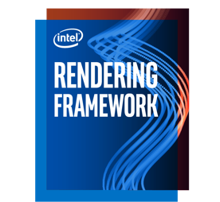
Intel® oneAPI Rendering Toolkit
What is it?
Open Source Libraries Developed by Intel
Used in leading applications for prof. rendering & vis
Optimized for parallel processing architectures
Provides
Access to all system memory space for largest data sets
Improved visual fidelity via ray tracing with global illumination
Cost efficient, interactive performance for any size data
Professional Rendering Stack
Scientific Rendering Stack
Application
Application
Renderer
OpenGL* Renderer
Intel® OSPRay Renderer
Intel® Embree Kernel Library
Intel® Open Volume Kernel Library
OpenGL* (Mesa)
Intel® Open Image Denoise
OpenSWR
OSPRay+Embree+OpenVKL+OID
Intel® Xeon® processor + Intel® Xe architecture-based GPU
Intel® Xeon® processor + Intel® Xe architecture-based GPU
  Using parallel processing optimized libraries to enable high-performance, high-fidelity applications on Intel® platforms
22
*Other names and brands may be claimed as the property of others

Slide 23
Intel® oneAPI Rendering Toolkit Overview
Open source and IA optimized software for high fidelity rendering
http://software.intel.com/intelrf

Slide 24
Intel oneAPI Rendering Toolkit: OpenSWR
OpenSWR
High-performance CPU rasterization via OpenGL* standard
Fully integrated and upstreamed into OpenGL Mesa3D project
Today: Supports OpenGL 3.3
Future: OpenGL 4.6+
http://mesa3d.org; http://www.openswr.org
General Visualization / Rendering Stack
Application
OpenGL Renderer
OSPRay Renderer
Mesa3D
Embree
Open Image Denoise
OpenSWR
Processor (Intel® Xeon ® and Intel® XE Architecture GPU)
24
Notes:
Supports ParaView, Visit, VTK, EnSight, VL3

Slide 25
Intel oneAPI Rendering Toolkit: openSWR
OpenSWR
High-performance CPU rasterization via OpenGL* standard
Fully integrated and upstreamed into OpenGL Mesa3D project
Today: Supports OpenGL 3.3
Future: OpenGL 4.6+
http://mesa3d.org; http://www.openswr.org
MPolys/sec (higher is better)
Configuration Information: Kitware* VTK* Performance Tests. Intel tested 4/01/19, Test Platform 2x Intel* Xeon Platinum 8180 processor @ 2.5 Ghz. CentOS v7.5. Mesa v19.0.1. llvmpipe default config, OpenSWR enabled via env. Variable, GALLIUM_DRIVER=swr;
Software and workloads used in performance tests may have been optimized for performance only on Intel microprocessors. Performance tests, such as SYSmark and MobileMark, are measured using specific computer systems, components, software, operations and functions. Any change to any of those factors may cause the results to vary. You should consult other information and performance tests to assist you in fully evaluating your contemplated purchases, including the performance of that product when combined with other products. For more information go to www.intel.com/benchmarks. Performance results are based Intel estimates and testing as of 04/24/2019 and may not reflect all publicly available security updates. See configuration disclosure for details. No product or component can be absolutely secure. Intel, the Intel logo, and others are trademarks of Intel Corporation in the U.S. and/or other countries. *Other names and brands may be claimed as the property of others.
Notes:
We’ve seen OpenSWR scale much more linearly with number of cores than llvmpipe ➔ up to 2 orders of magnitude
This means you can do interactive rendering directly on CPUs with no specialed hardware required

Slide 26
Intel oneAPI Rendering Toolkit: EMBREE
Embree
Highly optimized ray tracing kernel library
Low-level API for acceleration structures and ray / geometry intersections
Broadly adopted in professional rendering space
http://embree.github.io
General Visualization / Rendering Stack
Application
OpenGL Renderer
OSPRay Renderer
Mesa3D
Embree
Open Image Denoise
OpenSWR
Processor (Intel® Xeon ®)
Processor (Intel® Xeon ® and Intel® XE Architecture GPU)
26

Slide 27
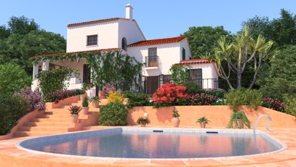

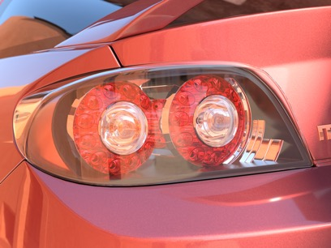


Intel oneAPI Rendering Toolkit: EMBREE
Embree
Highly optimized ray tracing kernel library
Low-level API for acceleration structures and ray / geometry intersections
Broadly adopted in professional rendering space
http://embree.github.io
The Grinch, Illumination Studios
Embree with Corona Renderer
27

Slide 28

Intel® Embree Ray Tracing Kernel Library
Open Source, High Performance, Feature Rich

Slide 29

Intel® Embree Ray Tracing Kernel Library
Open Source, High Performance, Feature Rich
Trolls Image rendered by MoonRay (with Intel® Embree) :
Property of DreamWorks Animation

Slide 30
Intel oneAPI Rendering Toolkit: Open Image Denoise
Open Image Denoise
High-performance denoising library for ray tracing using machine learning methods
Improved quality images faster, without losing detail
More denoising techniques coming
v1.0 Just Released!
http://openimagedenoise.org
General Visualization / Rendering Stack
Application
OpenGL Renderer
OSPRay Renderer
Mesa3D
Embree
Open Image Denoise
OpenSWR
Processor (Intel® Xeon ®)
Processor (Intel® Xeon ® and Intel® XE Architecture GPU)
30
Notes:
Our newest library, just released at SIGGRAPH 2018

Slide 31
Original
Crytek Sponza rendered at 16spp. Scene courtesy of Frank Meinl, downloaded from Morgan McGuire’s Computer Graphics Archive.

Slide 32
Denoised
Crytek Sponza rendered at 16spp. Scene courtesy of Frank Meinl, downloaded from Morgan McGuire’s Computer Graphics Archive.

Slide 33
Coming Soon: Intel® Open Volume Kernel Library
Coming by “Monday” Sept 30.
Free and Open Source under Apache 2.0* license
Optimized Volume kernels
  Structured
  Unstructured
  Adaptive Mesh Refinement(AMR)
  Volumetric Path Tracing Sample App
OpenVDB* support in Q4’19
33
*Other names and brands may be claimed as the property of others

Slide 34
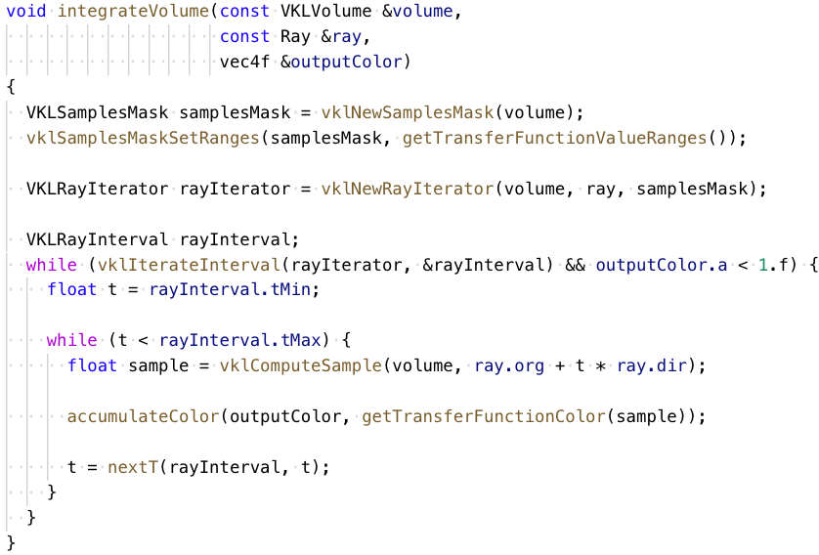
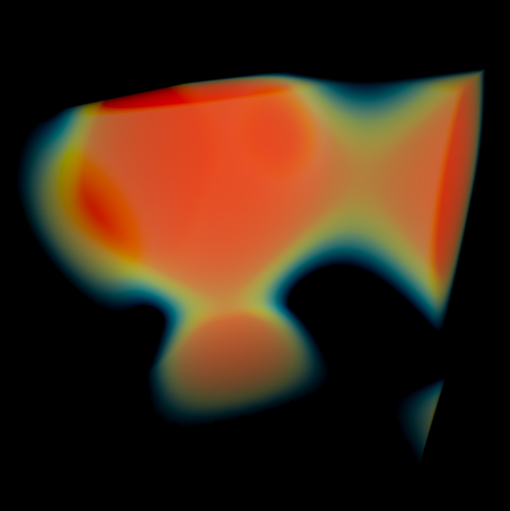
Volume integration example

Slide 35
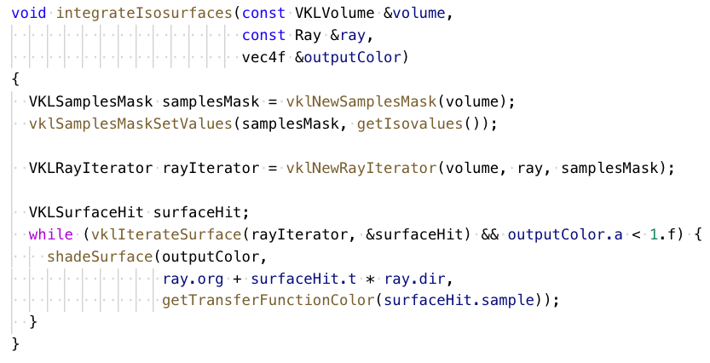
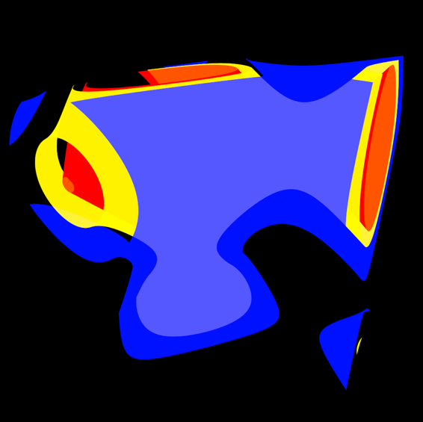
Isosurface rendering example
Notes:
We have ISPC bindings as well, so you can write explicitly vectorized code!

Slide 36
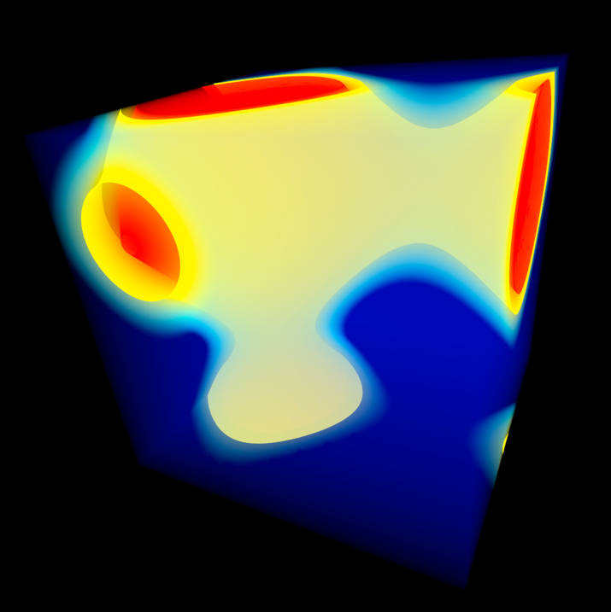
Combined volume + isosurface rendering…
Straightforward extension of previous code combining both forms of iteration

Slide 37
Intel oneAPI Rendering Toolkit: OSPRAY
OSPRay
Open, Scalable, Portable Ray tracing library
High-level rendering API
3D Geometry, Volumes or both!
An SDK to develop Vis Apps
Extensible via Plug-In Modules
OSPRay Studio App Included
Leverages Embree + Open Image Denoise
http://www.ospray.org
General Visualization / Rendering Stack
Application
OpenGL Renderer
OSPRay Renderer
Mesa3D
Embree
Open VKL
OpenSWR
Open Image Denoise
Processor (Intel® Xeon ®)
Processor (Intel® Xeon ® and Intel® XE Architecture GPU)
37

Slide 38
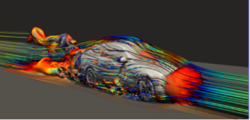
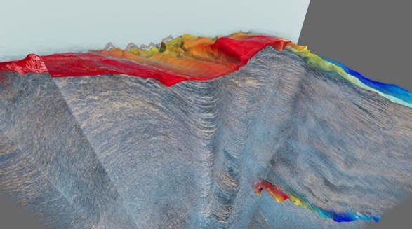
Intel oneAPI Rendering Toolkit: OSPRAY
OSPRay
Open, Scalable, Portable Ray tracing library
High-level rendering API
3D Geometry, Volumes or both!
An SDK to develop Vis Apps
Extensible via Plug-In Modules
OSPRay Studio App Included
Leverages Embree + Open Image Denoise
http://www.ospray.org
Gravational Waves : GR-Chombo AMR Data, Stephen Hawking CTC, UCambridge; Queens College, London; visualization, Carson Brownlee, Intel, ParaView)*
OpenFOAM*, ParaView* with OSPRay Path Tracer
The Moroccan Ocean Shelf. Image courtesy of the Bureau of Economic Geology at The University of Texas at Austin and the Moroccan National Office of Hydrocarbon and Mining.
Magnetic Reconnection Model, Courtesy Bill Daughton(LANL) and Berk Geveci(Kitware)*
38
Notes:
Scalable => single CPU up to cluster parallel with MPI
Large scale data no problem, if it fits in memory we can render it ➔ some of these data sets are 100s of GBs
Combined volume and surface rendering

Slide 39
Example: OSPRay
CPU-based Rendering
Interactive Path Tracing
The Bentley* Continental GT rendered @ 10-100 fps with Intel® OSPRay using 8 - 128 nodes Intel® Xeon® Platinum 8160 processors run on TACC Stampede 2, Univ. of Texas, Austin.
39
*Other names and brands may be claimed as the property of others

Slide 40

INTEL® ONEAPI RENDERING TOOLKIT ROADMAP
Q3 2019
Q4 2019
3.6
Multi-Instances
Nearest Neighbor Queries
Catmull-Rom Based Curves
3.7
Motion Blur Quaternians
Fat Linear Curves
Embree
OSPRay 2.0
Async Rendering
Improved Instancing
Advanced Picking
2.1
Path Traced Vol. Rendering
Clipping Geometries
OSPRay
19.3
Feature Parity with LLVMPIPE
20.0
OpenGL* v4.0 support
OpenSWR
1.1
Training Code / Methods
1.2
Temporal Handling
Fine Geometry
Open Image Denoise
1.0
Quality improvement
New memory management
OpenVKL 0.9
1st release
1.0
OpenVDB
PT Volume
Open VKL

Slide 41


Exponentially scalable : Xe architecture
Datacenter optimized
Datacenter/AI
Enthusiast
Mid-Range
Integrated + Entry
Performance
Client optimized
Gen11
Roadmap includes HW Ray Tracing
G9
G8
RT Software Support:
Intel oneAPI Rendering Toolkit
DirectX Ray Tracing (DXR)
Vulcan RT Extensions
G7
G6
Time
Intel may make changes to specifications and product descriptions at any time, without notice. The information here is subject to change without notice. Do not finalize a design with this information. Intel technologies’ features and benefits depend on system configuration and may require enabled hardware, software or service activation. Performance varies depending on system configuration.
41

Slide 42



Intel® Graphics and Visualization Institutes of XeLLENCE
Intel® Graphics and Visualization Institutes of XeLLENCE
Texas Advanced Computing Center
Visualisierungsinstitut der Universität Stuttgart
Scientific Computing and Imaging Institute
Chaos Research and Charles University

Slide 43
NOW, Back to our regularly scheduled program

Slide 44
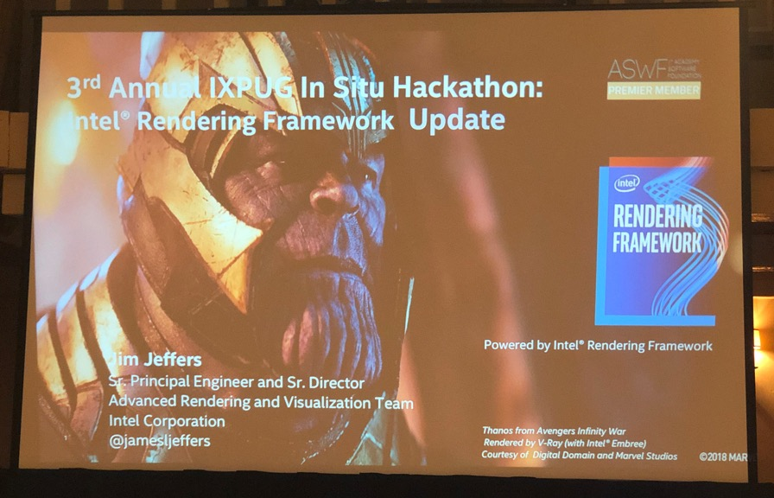
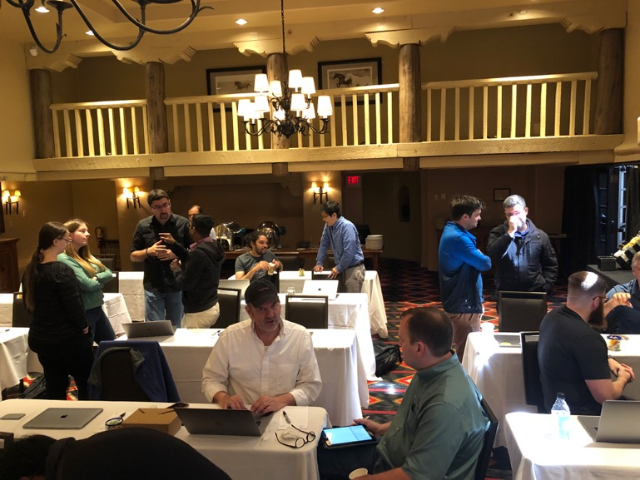
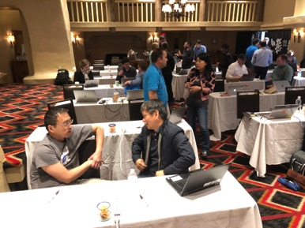
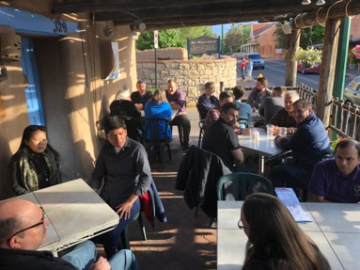
IXPUG In Situ Analysis Hackathon
https://www.ixpug.org/events/in-situ-hackathon

Slide 45
IXPUG In Situ Hackathon Purpose
The Hackathon provides a forum to bring simulation developers together with visualization experts for hands-on implementation of in situ analysis.
Get all the right people in the same room at the same time with enough time and few distractions so they can get things done!

Slide 46
IXPUG In Situ Hackathon Key Lessons
Hackathon environment is successful!
  Have had to preempt hacking each year for networking event
  (attendees choosing more coding over free food and beer!)
Distraction-free environment is key
  Attaching to another event (ISC, SC) prevents focused development
  Target May timeframe – after spring semester, before summer plans
  Impromptu projects arise from having time and people available
Good mix of new and returning participants
  Seeing value in attendance, accomplishments grow each year
  Continuing to seed with new attendees, new problems, new codes
Continue to outreach to simulation communities
  US DOE Exascale program
  EU EuroHPC Exascale program (next hackathon in Europe?)

Slide 47
IXPUG In Situ Hackathon 2017
Austin, Texas – hosted at TACC
  40 participants: 23 academic, 13 industry, 4 national lab
  14 project teams
    GRChombo + Catalyst
    Alpine + WALLS
    libMesh + Catalyst
    RHEA + Catalyst
    Intestinal Villi + OSPRay; Villi + MegaMol
    LAMMPS + Sensei + OSPRay
    VisIt + LibSim + OSPRay
    VisIt + LibSim + OpenSWR
    VisIt + LibSim + VTK 7.x
https://www.ixpug.org/events/swdvis-2017

Slide 48
IXPUG In Situ Hackathon 2018
Chicago, Illinois – hosted at Argonne National Lab
  28 participants: 15 national lab, 8 academic, 5 industry
  12 project teams
    Ascent + ADIOS; Conduit + ADIOS
    HACC + Catalyst
    VTK + OSPRay - distributed data first light
    NWChem + GPUAM+ Sensei; GAMESS + GPUAM + Sensei
    MegaMol + Sensei; MegaMol + ADIOS
    ADIOS2 improvements
    GRChombo + Catalyst – ghost zones, AMR
    Sensei + OSPRay
    MPAS-A + Catalyst; MPAS-O + Catalyst
    Nek5000 + Sensei
    Sight + OSPRay
    Sensei + Spark
https://www.ixpug.org/events/swdvis-2018

Slide 49
IXPUG In Situ Hackathon 2019
Santa Fe, New Mexico – hosted by TACC, LANL
  39 participants – 20 national lab, 10 industry, 9 academic
  19 project teams
    TOTAL flow + Cinema; TOTAL flow + Sensei
    NYX + Sensei; WarpX + Sensei; HACC + Sensei
    Sight + Sensei + Catalyst
    VTK-m + Ascent + Spack
    DNS turbulent channel flow + libIS
    MPM particle sim + Galaxy
    Sensei + libIS
    MPAS-Albany land ice model
    Lulesh AMT + Legion + Ascent
    Sampling for In Situ
    OpenVKL
    Athena + Catalyst
https://www.ixpug.org/events/in-situ-hackathon

Slide 50
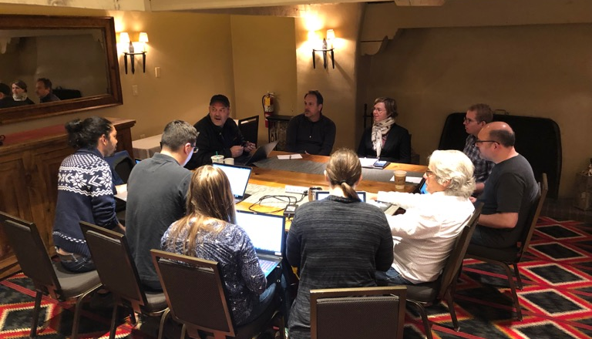
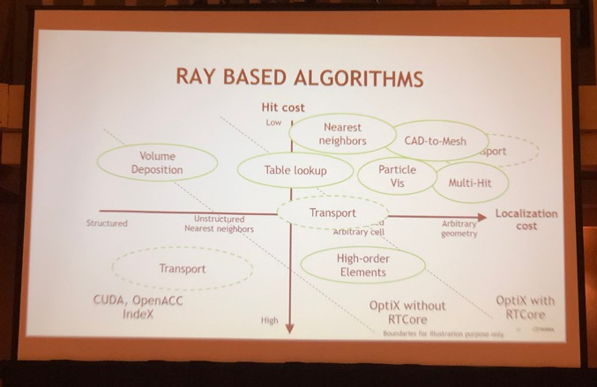
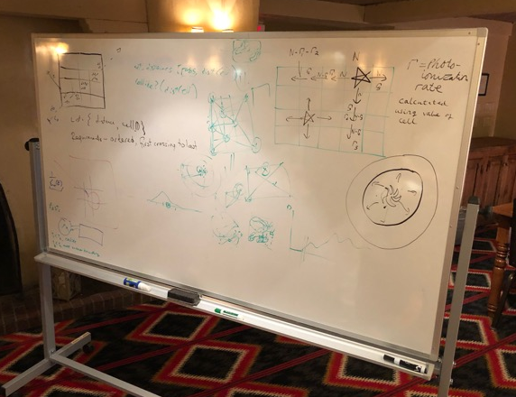
SOLAR Ray Tracing Consortium
https://sites.google.com/tacc.utexas.edu/solar

Slide 51
Scalable Ray-tracing Consortium (Solar)
Purpose: to advance the functionality, performance and use of scalable ray tracing on current and future node
and supercomputer architectures
Areas of Interest:
  Physics simulations with ray-tracing
  Visualization and data analysis with ray-tracing
  General ray-tracing APIs
  Hardware accelerated ray-tracing
  Distributed memory ray-tracing (DMRT)
  Efficient ray-tracing approaches on a variety of data representations (structured, unstructured, AMR. Etc)
  Integration of ray-tracing in software tools
  Ray-tracing benchmarks, test frameworks, prototypes, libraries
Value proposition: By showing shared interest and commitment, partners can advanced ray-tracing to the benefit of all contributing partners
  Partners contribute ideas, software and institutional support
  The consortium is not a funding mechanism for partners – project creation and support occurs outside the consortium through traditional channels

Slide 52
Solar Consortium Purpose(s)
Expand the ray tracing discussion beyond the production of pixels
  Many simulations perform calculations similar to ray tracing:
  radiative transfer, particle advection, etc.
  Can these simulations benefit from hardware-tuned implementations?
Organize a community around ray tracing for science
  Identify needed functionality
  Standardize interfacing to ray tracing engines
    For surfaces, volumes, particles, vectors, tensors…
    For simulation, surface rendering, volume rendering…

Slide 53
SOLAR meeting: May 30-31 @ Santa Fe
Thirty-eight registrants!
  18 National Labs
  7 Academia
Entities
  Argonne National Lab
  Army Research Lab
  Intel
  Intelligent Light
  Kitware
  Los Alamos National Lab
  Lawrence Berkeley National Lab
  11 Industry
  Lawrence Livermore National Lab
  NVIDIA
  Oak Ridge National Lab
  SCI @ University of Utah
  SURVICE Engineering
  TACC @ UT-Austin
  Total
  The University of Texas at Austin

Slide 54
Discussion points
Domains
  Particle/Radiation Transport
  Seismic Inversion/Digital Rock Physics
    Volume rendering used in analysis
  Algorithmic operations
    Remapping between grids
    Voronoi tessellation of 3D space
Algorithmic overlaps with raytracing
  Hit detection
  Ray integration
  Ray propagation
  ‘Action’ taken at the end of each loop iteration
Two Types of Simulations:

Slide 55
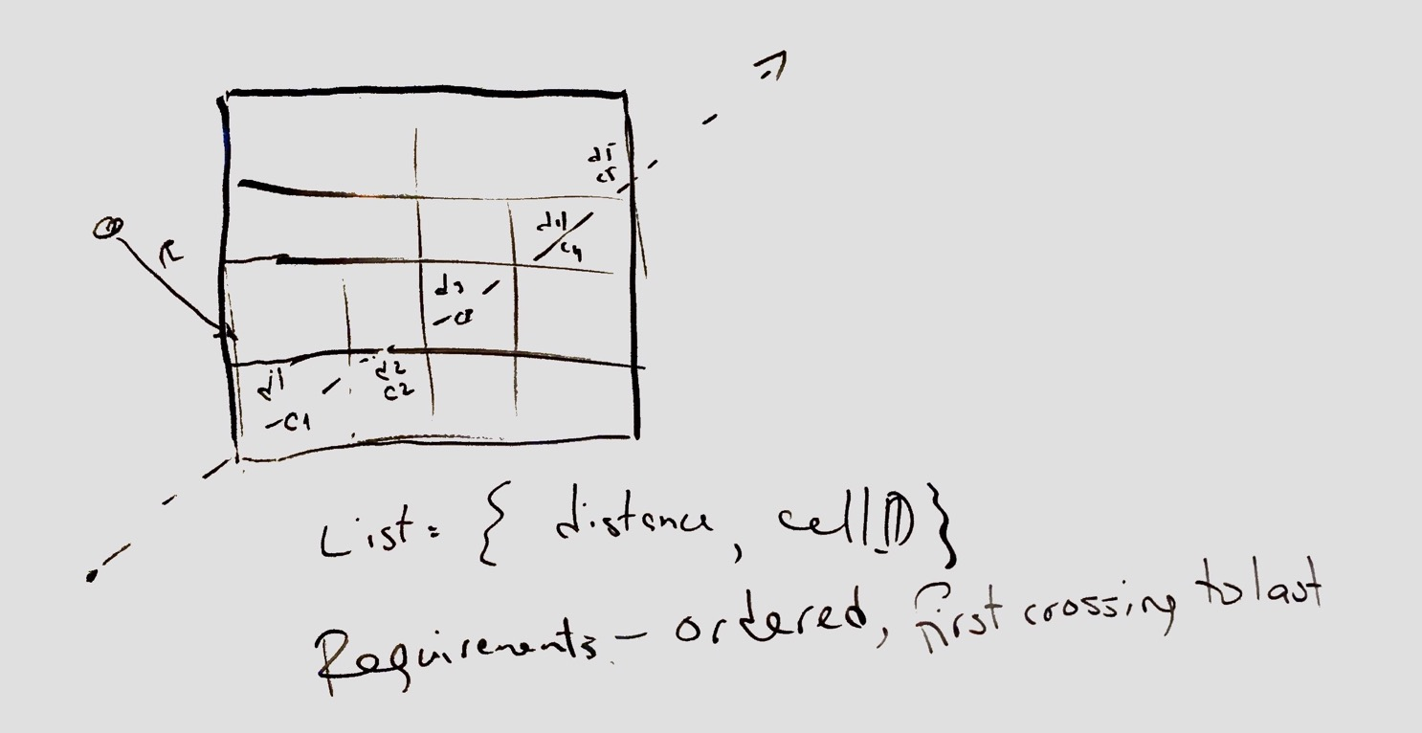
Rays Determine Distances and Paths, and Carry No Information

Slide 56
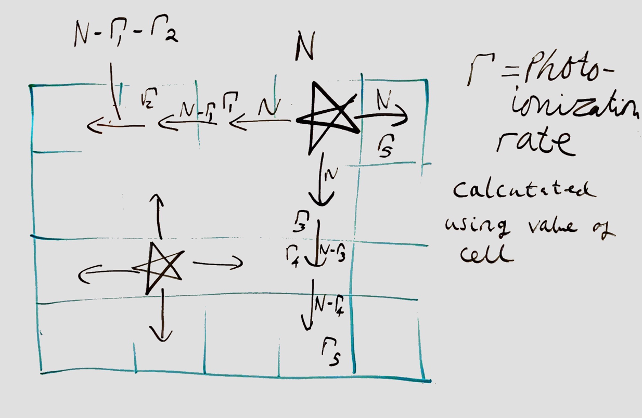
Rays Modify the State of the System, and Carry Information

Slide 57


Consensus: lots of similarities

Slide 58
Definitions to standardize
Ray
  Does a ray carry information?
Ray Sources
  Point source (stars)
  Ray list generator
Ray Propogation/Scattering
  Handled by science codes in the simulation loop
Interaction between ray and mesh data
  May change the material/grid data

Slide 59
Next Steps
At its heart, this may be 90% a terminology problem
Proposal:
  Raytracing 101 for scientists
  Presentations on raytracing loops from science codes

Slide 60
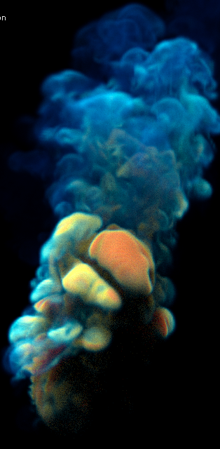
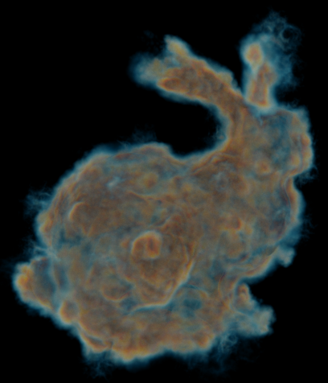
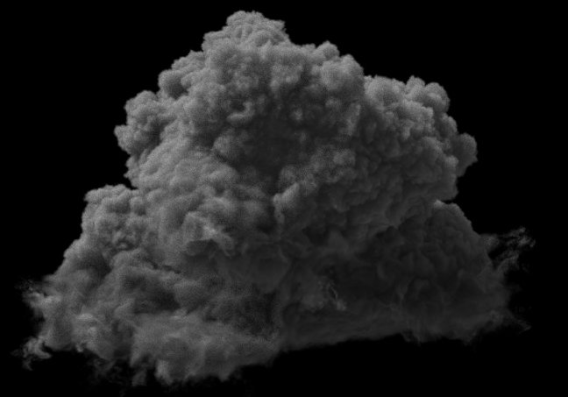
Let’s End on some Cool Pictures: Intel® Open Volume Kernel Library
The Disney Cloud: public dataset courtesy of Walt Disney Animation Studios

Slide 61
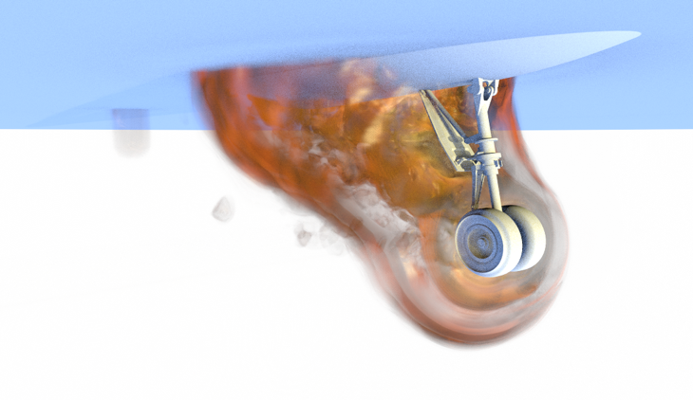
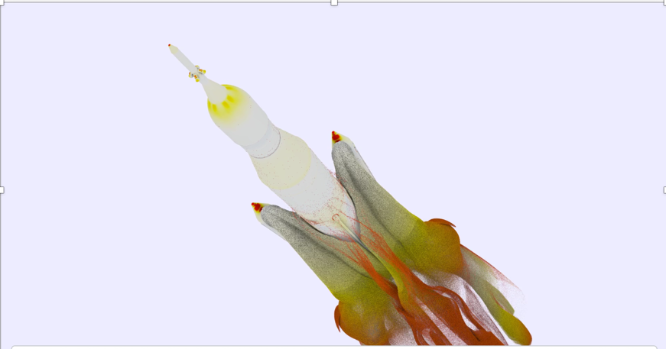
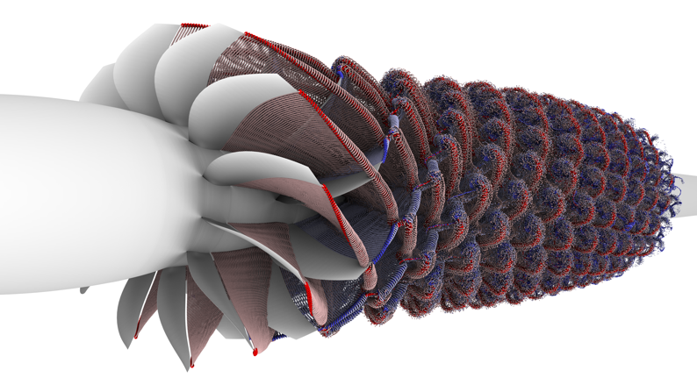
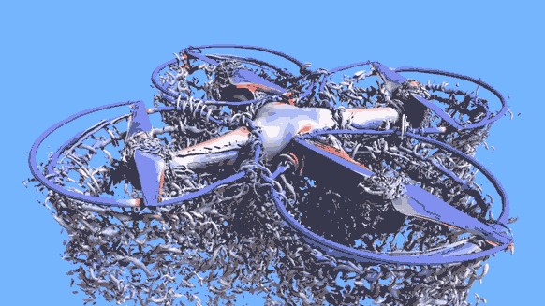
“Houston: boosters have separated”: From our friends at NASA using Intel® OSPRay and Intel® Embree
Data and Images courtesy of Tim Sandstrom and Pat Moran, NASA Ames

Slide 62
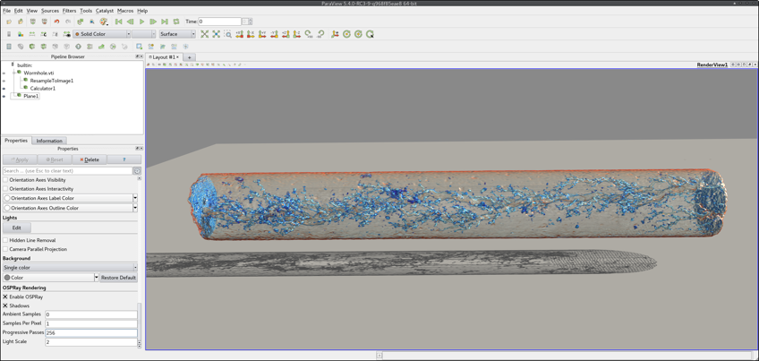
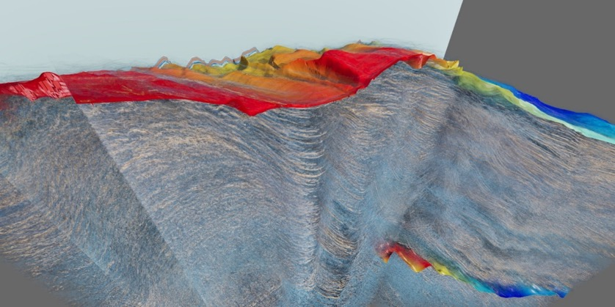
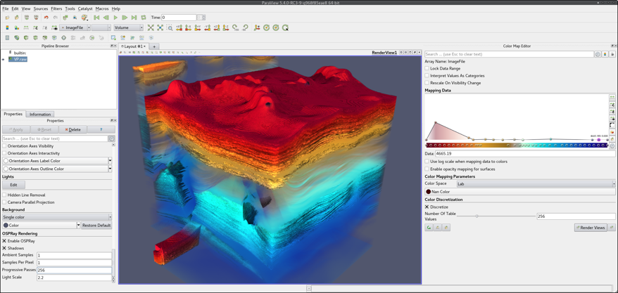
“..first thing you know old Jed’s a millionaire..”: OSPRay in Oil & Gas
The Moroccan Ocean Shelf. Image courtesy of the Bureau of Economic Geology at The University of Texas at Austin and the Moroccan National Office of Hydrocarbon and Mining.
“Worm Hole” and ‘p-wave velocity”: Kitware ParaView with OSPRay, Data and Images Courtesy of Bruno Conche, TOTAL

Slide 63
THANK YOU!
Questions? …. And ‘maybe’ honest answers…..☺

Slide 64
Legal Notices and Disclaimers
Intel technologies’ features and benefits depend on system configuration and may require enabled hardware, software or service activation. Learn more at intel.com, or from the OEM or retailer.
No computer system can be absolutely secure.
This document contains information on products, services and/or processes in development. All information provided here is subject to change without notice. Contact your Intel representative to obtain the latest forecast, schedule, specifications and roadmaps.
No license (express or implied, by estoppel or otherwise) to any intellectual property rights is granted by this document.
Tests document performance of components on a particular test, in specific systems. Differences in hardware, software, or configuration will affect actual performance. Consult other sources of information to evaluate performance as you consider your purchase. For more complete information about performance and benchmark results, visit http://www.intel.com/performance.
Intel does not control or audit third-party benchmark data or the web sites referenced in this document. You should visit the referenced web site and confirm whether referenced data are accurate.
Intel, the Intel logo, Core, and others are trademarks of Intel Corporation in the U.S. and/or other countries. *Other names and brands may be claimed as the property of others.
© 2018 Intel Corporation.
Intel's compilers may or may not optimize to the same degree for non-Intel microprocessors for optimizations that are not unique to Intel microprocessors. These optimizations include SSE2, SSE3, and SSSE3 instruction sets and other optimizations. Intel does not guarantee the availability, functionality, or effectiveness of any optimization on microprocessors not manufactured by Intel. Microprocessor-dependent optimizations in this product are intended for use with Intel microprocessors. Certain optimizations not specific to Intel microarchitecture are reserved for Intel microprocessors. Please refer to the applicable product User and Reference Guides for more information regarding the specific instruction sets covered by this notice.
Cost reduction scenarios described are intended as examples of how a given Intel-based product, in the specified circumstances and configurations, may affect future costs and provide cost savings. Circumstances will vary. Intel does not guarantee any costs or cost reduction.
64

