Slide 1
HPC Lunch and Learn
March 2019
Deep Learning Applications in Manned Spaceflight
Matthew Noyes
NASA JSC - Advanced Operational Concepts Lab
Lawrence Hessburg Lui Wang
Graduate Student AR Lead

Slide 2
Agenda
Deep Learning Overview/Definitions
Intelligent Personal Coach
  Use of open source datasets for space applications
Safety Analysis with Deep Learning
  Use of open source datasets for space applications
6DOF Object Pose Estimation with Virtual Training Dataset
  Doing deep learning with hard-to-generate datasets
Potential Areas of Research/Future Needs for Space Applications

Slide 3
Intro - What is “Deep Learning”?
Artificial Intelligence – a simulation of intelligent systems
Machine Learning – Self-modifying AI
Deep Learning – Self modifying AI with multiple hidden layers
Neural Networks/Deep Learning attempt to replicate the structure of the human brain on a rudimentary level
Notes:
AI = computer vision, text-to-speech, speech-to-text. Can be simple if-else statements, or statistical in nature
Machine Learning = adjust themselves in response to input data. A dynamic form of AI
Give basic high level overview on what Neural networks are. What is the motivation to create such a structure. Two cars. Easy for a human to tell you. Writing a program to do it with traditional software engineering principles. There is enough information encode in the pixels to determine that both are pictures of cars. Neural network should model function of neurons in the brain. Multiple inputs with weighted sums, once add up, fire.
Multiple layers shows that real values are when you connect together many nodes.

Slide 4
What is “Training”?
Basic steps of training:
  Weights are initially randomized
  Feed training examples through network and compute Loss at output
  Reinforce “good” weights through backpropagation
  Evaluate performance on test examples
  Repeat
Must have accurate Loss function and large, diverse, labeled training set
Notes:
Find a balance between explaining and without much detail.
Top level overview of what training is, then go into more detail on the next few slides.
Forward pass –
Activation function – scales or compresses or squashes data into something more manageable to the next layer.
Different network architectures have different layer shapes and sizes. May be different than basic weighted sum. What is the target operation of this model? Convolution (images), recurrent (natural language)
Compute loss at output. Loss is the measure of distance between the real output and desired output. Gradient Descent – each weight in the network needs to be updated according to loss in network. Gradient of loss at output with respect to each weight in the network. High dimensional system of differential equations. Tells you which direction weight needs to go to more optimally reach desired output. High D space, send gradients to get to the minimum or optimum. Loss is function of outputs, output a function of weight, backpropagation: use chain rule of derivatives. This is a specialized case of automatic differentiation. Push gradient back through network. Descend gradient to reach global minimum.
Inefficient to compute back propagation for every sample. Mediated via batch learning. Gradient at output averages across all examples in the batch. You lose a little precision but it speeds up training by factor of hundreds.
For any nontrivial problem, need 1000s to 10s of thousands of samples for a “large” dataset.

Slide 5
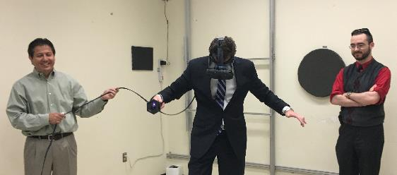
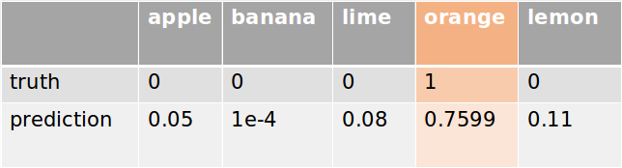
Useful Definitions
Loss - How far is the prediction from the truth?
Precision - How many of the predictions are correct?
Recall - How many of the objects were found?
Mean Average Precision - Takes into account both Precision and Recall
Ground Truth - Known, labeled example
high precision (100%) , low recall (50%)
low precision (50%) , high recall (100%)
Notes:
Common basic loss function – mean squared error.
Cross entropy for binary classification problem.
Top: high precision, low recall
Bottom: low precision, high recall.
Mean average precision – for each image in the dataset, 10 levels of recall, average the precision, and average over all the dataset
Loss – metric used for evaluating performance during training.
In general - measure of a prediction’s distance from the truth
Localization loss – size, shape and location of bounding boxes
Classification loss – correct/incorrect class prediction
Two different but important metrics for accuracy, precision and recall
Precision – How many predictions are correct?
Recall – How many objects were found?
Precision and Recall are only useful in the context of each other
Mean Average Precision
For a given test image, measure the precision at 10 levels of recall (10% - 100%) and take the average. This is Average Precision (AP)
Take the mean of AP values across all test images, this is mean Average Precision (mAP)
Each bounding box has a confidence score – we can reduce the confidence threshold to achieve a desired precision

Slide 6
Intelligent Personal Coach

Slide 7
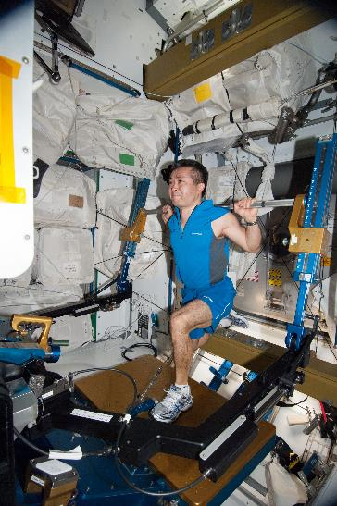
Intelligent Personal Coach - Background
Exercise is vital
Communication delay
Characteristics of Intelligent Personal Coach:
  Health/Performance monitoring
  Workout/Lesson Planning
  Remediation - real-time guidance during exercise
Notes:
Average: 2 hours exercise required every day
Mars round-trip communication delay: between 8 min and 48 min
Deep Space missions, personal coach due to long communication delay. Planning workouts.

Slide 8
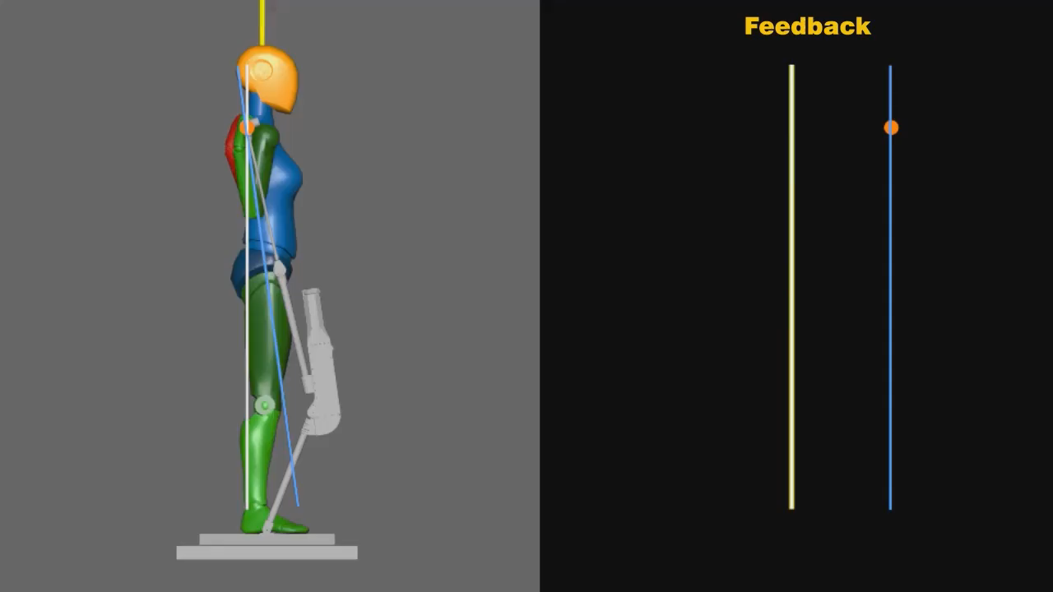
Intelligent Personal Coach - Requirements
Real-time feedback
Intuitive UI, easy to act upon
No wearables - visual or audio feedback only
Initially focused on simple squat exercise:
  Keep upper back straight
  Keep chest up
  Keep correct bar path during range of motion
Notes:
White line = vertical axis (ideal back angle)
Yellow line = true back angle relative
Blue line = weight bar axis (ideal bar path)
Orange dot = bar cross section

Slide 9
Intelligent Personal Coach - openpose
Openpose: deep-learning based human pose estimation framework developed by CMU
Accurate keypoint detection for desired joints
Works on any image/video feed (i.e. webcam)
But: joint keypoints in image-space isn’t enough to accurately judge exercise form
Notes:
New version supports digits, but it’s not necessary for our needs

Slide 10
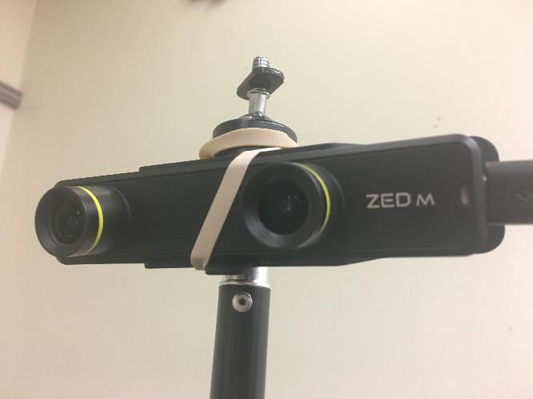
Intelligent Personal Coach - ZED camera
Uses dual-camera parallax to estimate depth in an image/video
Realtime depth map at full camera resolution
Combine depth map with joint keypoints to determine form

Slide 11
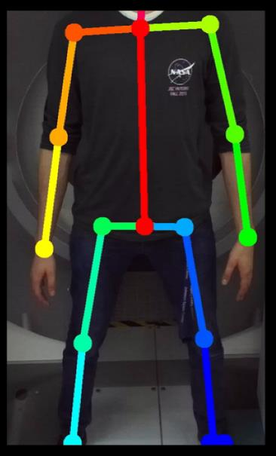
Intelligent Personal Coach - BodyModel
BodyModel class to integrate pixel-space keypoints from openpose with depth info from ZED camera.
ZED video stream feeds to openpose network
Underlying layer visualizations can be built upon

Slide 12

Intelligent Personal Coach - Design
Single ZED camera mounted directly in front of subject on the ceiling.
Short throw projector on opposing wall for visualization
Software automatically compensates for camera pitch angle
Notes:
Added command line flags for recording and concatenation for video.
Animation and video

Slide 13
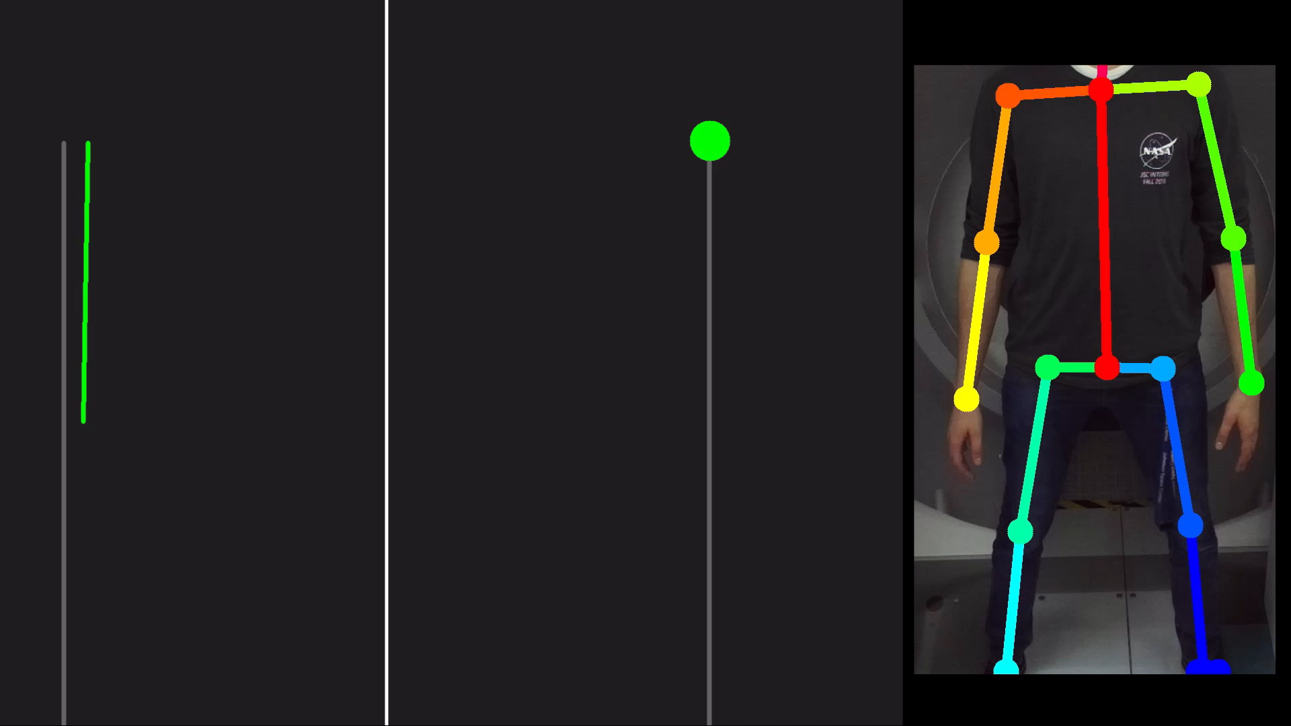
Intelligent Personal Coach - Results

Slide 14
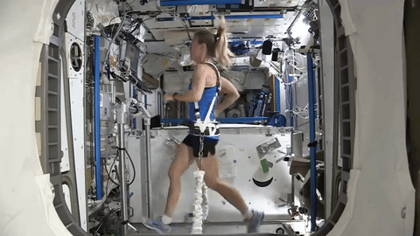
Intelligent Personal Coach - Future work
Create visualizations for other exercises
Utilize more robust UI framework for visualization
Gamification
Hardware optimization
Notes:
Jog through trail. File stream provided by zed camera can only be accessed by one thread at a time. Grabbed frames with OpenCV, translate into matrices that could be sent to openpose. 14 frames of latency, need lower level data representations.

Slide 15
Safety Analysis with Deep Learning

Slide 16
DML Safety Analysis - Motivation
Micrometeoroid and Orbital Debris (MMOD) damage identification on the ISS:
  MMODs on handrails can tear spacesuit gloves.
  Tedious process: human in front of the screen zooming and inspecting images manually for hours
  Introduces opportunity for human error due to fatigue, attention span, etc.
Develop a system to identify handrails in images
  Goal: assist imagery team by automating this manual and laborious process.

Slide 17
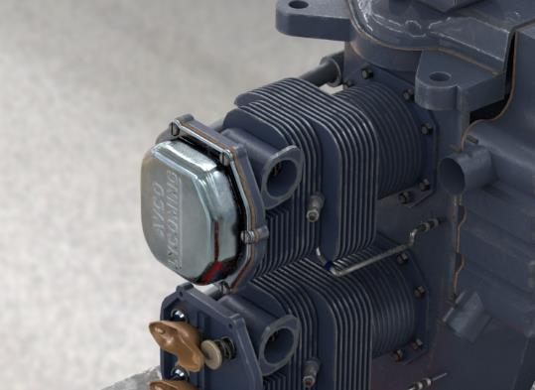




Faster R-CNN - 2D Case
Trains to predict bounding boxes around image objects
  2 steps: localization, and classification
Training data: both images and bounding box coordinates
Network will predict 4 points in pixel space and a class for each object it finds
$$(x_{3},y_{3})$$
$$(x_{4},y_{4})$$
$$(x_{1},y_{1})$$
$$(x_{2},y_{2})$$
Notes:
This is a 3D rendered image. Ask Marco for specifics. Only 50 photos of real thing.
Faster R=CNN 2 phase: 1) generate regions of interest with confidence value, to prune the search space. 2) Look at more detail. Not the fastest or best in 2019
Training time on the order of 2-8 hours, all running on a desktop computer

Slide 18
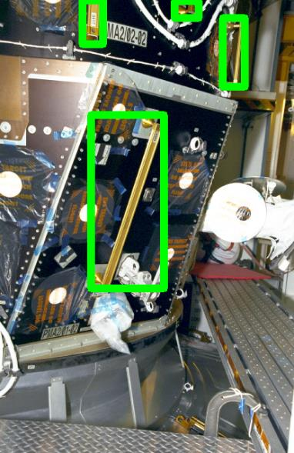
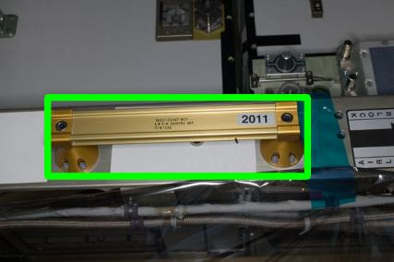
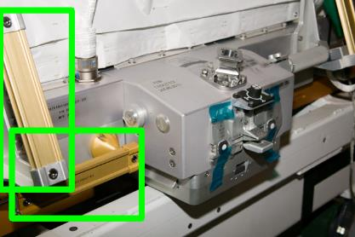
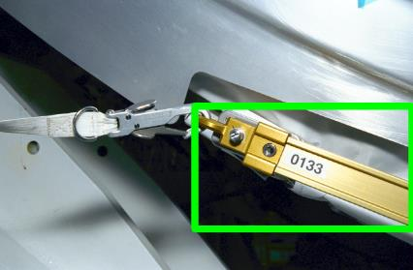
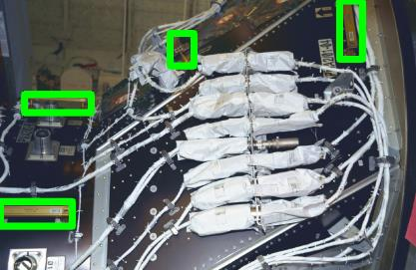
DML Safety Analysis – Training Pictures

Slide 19
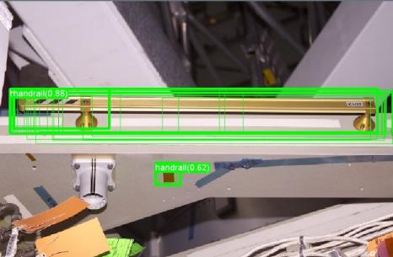
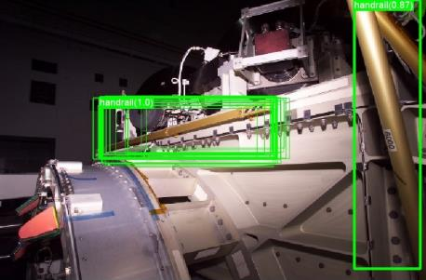
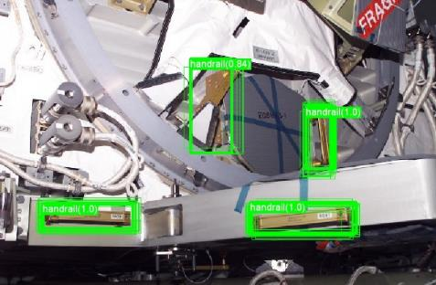
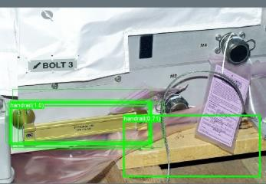
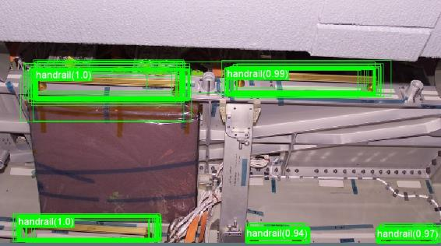
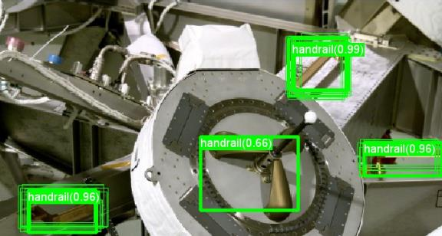
DML Safety Analysis – False Positives

Slide 20
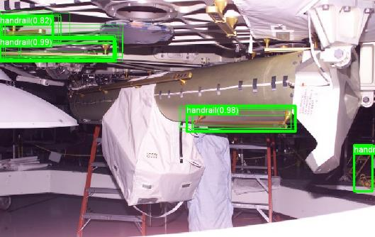
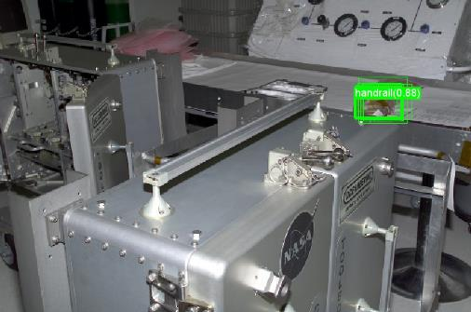
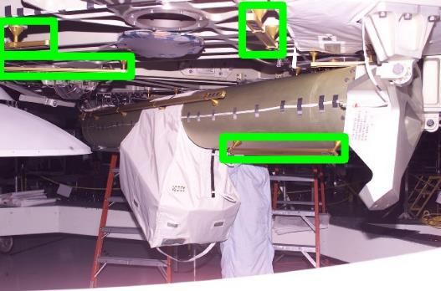
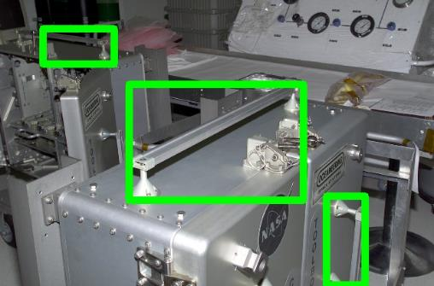
DML Safety Analysis – False Negatives

Slide 21
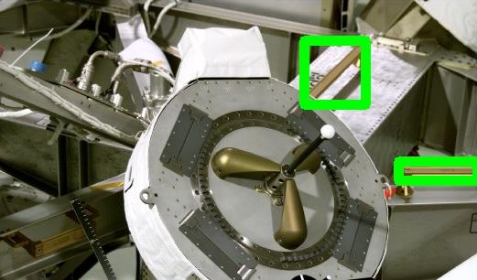

Better and Worse than Human
Human labeled image
DML resulting labeled image:
Found a missing handrail from human labeled image
Found a False Positive

Slide 22
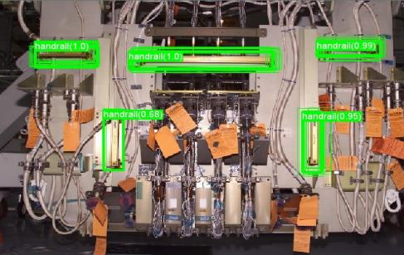
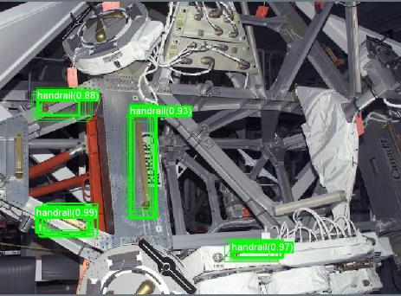
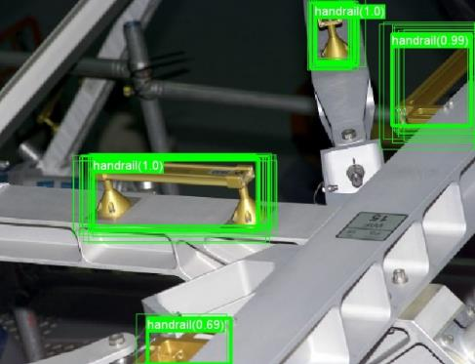
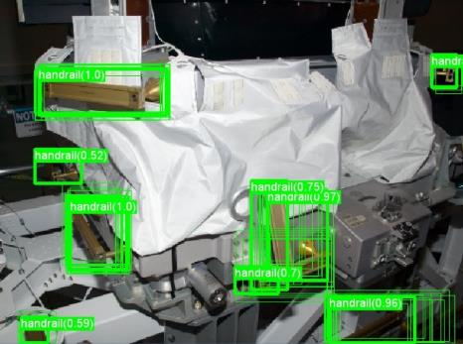
Success in Complex Images

Slide 23
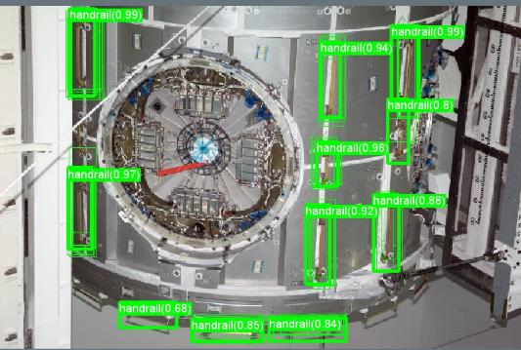
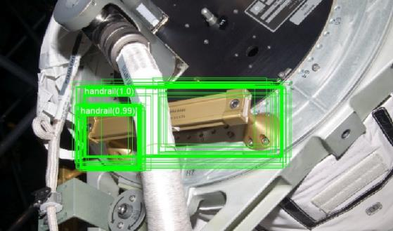
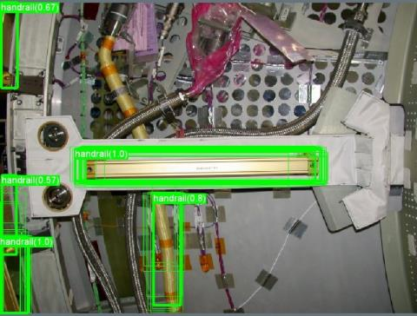
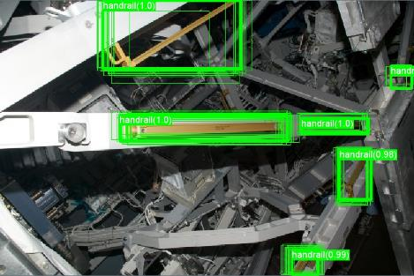
Success in Complex Images

Slide 24
DML Safety Analysis - Issues
Number of images for training and validation too low
Existing labels of images not accurate
Labeling images is manual intensive

Slide 25
6DOF Object Pose Estimation with Virtual Training Dataset

Slide 26
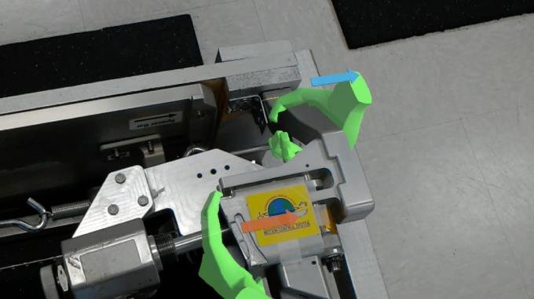
Object Pose Estimation - Background
Motivation - AR Object Alignment
  AR procedure assistant needs to align a 3D model with reality
  Traditionally done with sticker anchors
Main Problems
  If the object moves relative to the sticker, the AR model cannot compensate.
  Can only register by looking directly at the sticker
  Inertial drift
Notes:
Automated procedure assistant. Automated docking procedure (dissimilar redundancy). Along the same lines as opnav, judge 3D position in space using purely visual data. Autonomous vehicles: Robonaut grabbing objects, using tools in a generalized.

Slide 27
Object Pose Estimation - Background
Goal - eliminate the need for stickers using deep-learning based pose estimation.
  “Continuous” object registration to eliminate drift
  Support for partial occlusion, many more viewpoints
  Support for different geometries
Requirements
  NN that takes RGB image as input, produces 6-DOF pose estimation as output
  Large, diverse training dataset of 6-DOF labeled images.

Slide 28
Object Pose Estimation - Approach
Acquiring and manually labeling a large enough dataset to be useful is a near-impossible task
Instead, use photorealistic renderings from CAD model as training data
  Generate thousands of pre-labeled images quickly
  Easily vary parameters (background, clutter, distortion, lighting, etc)
Two problem phases:
  Test viability of synthetic training data on simplified 2D case
  Advance to full 6-DOF predictions
Can we generate synthetic images with high enough quality to train on for a real test set?
Notes:
Marco has details about CAD rendering in Maya. Python script for labels.
Photorealism referred to reflectiveness and texture properties, as well as using offline renderer (raytracing).
Didn’t model camera noise. Should model camera noise.
2D bounding boxes, then advance to full 3D bounding boxes.

Slide 29
Object Pose Estimation - 2D Case
Detecting piston covers on Ellington Field airplane engines:
  3k-5k synthetic images rendered for each iteration
  Bounding boxes automatically generated in Maya
  ~50 photographs and several videos for testing
  Trained TensorFlow implementation of Faster R-CNN
  Relatively rapid series of small scale tests
$$(x_{3},y_{3})$$
$$(x_{4},y_{4})$$
$$(x_{1},y_{1})$$
$$(x_{2},y_{2})$$
Notes:
This is a 3D rendered image. Ask Marco for specifics. Only 50 photos of real thing.
Faster R=CNN 2 phase: 1) generate regions of interest with confidence value, to prune the search space. 2) Look at more detail. Not the fastest or best in 2019
Training time on the order of 2-8 hours, all running on a desktop computer

Slide 30
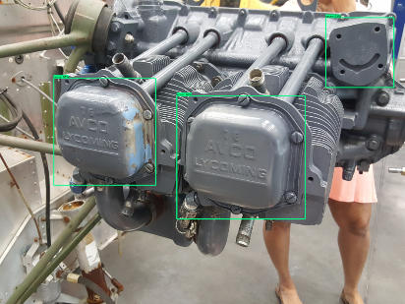
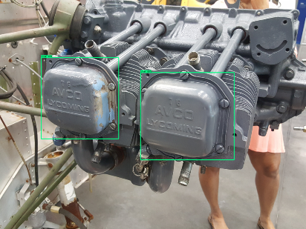
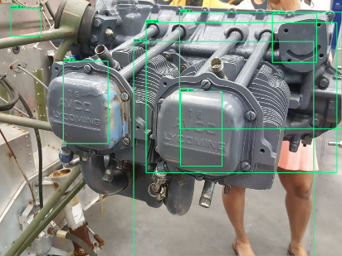
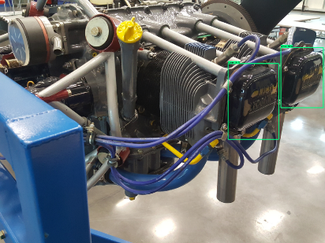

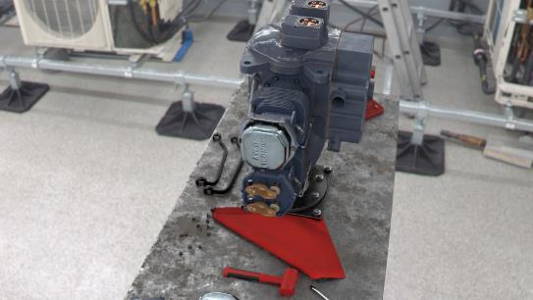

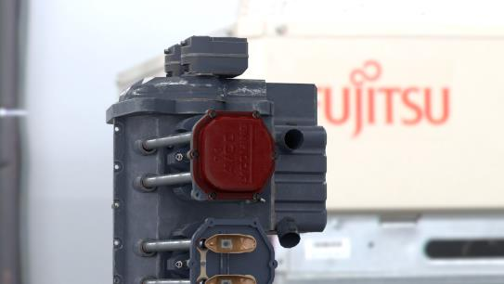
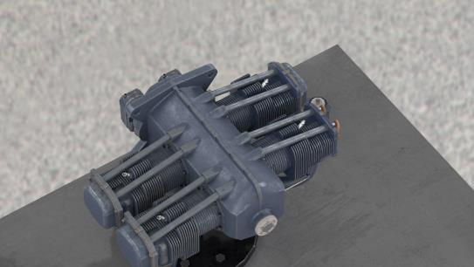
Object Pose Estimation - 2D Case
Identified sensitivities of network through many training iterations
Gradually added complexity to dataset (clutter, colors, reflectiveness, lighting, etc..)
Gradually tuned hyperparameters of network (batch size, learning rate, data preprocessing etc..)
Eventually reached >90% accuracy
Notes:
Rendering on the bottom. In an earlier presentation, Lui and Jack gave a presentation with graphs of accuracy over time. Lui might have access to them
Filters, noise, flipping, rotating.

Slide 31
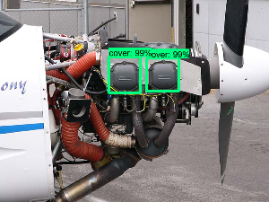
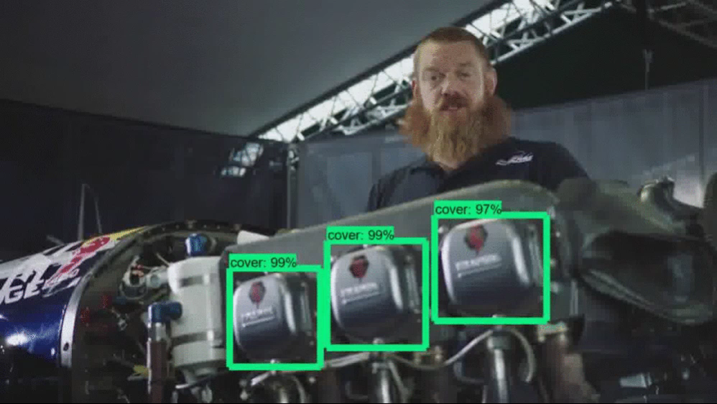
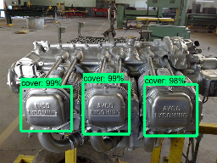
Object Pose Estimation - 2D case
© Red Bull Air Race / https://www.youtube.com/watch?v=OtdiLc_wajg
Notes:
Triggering off the shape of the piston caps, not on the color and texture.

Slide 32
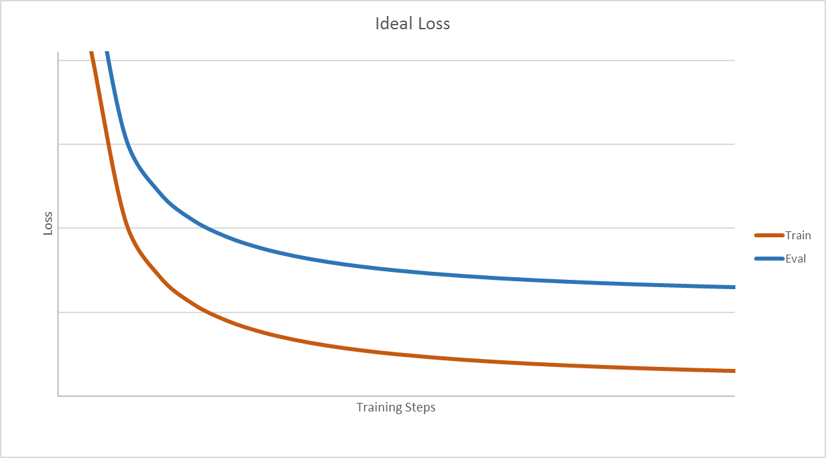
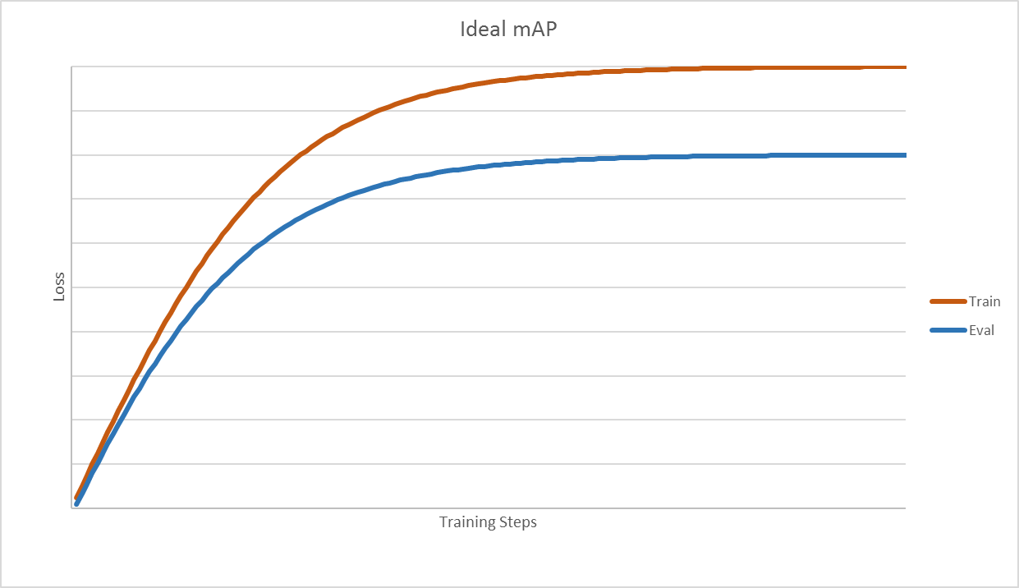
Implications – Ideal Case
Key observations:
Steep at first, then follows a shallow gradient
Both sets have the same general shape, even though the eval set has worse performance
Our configuration:
1000 synthetic training images
~30 manually labeled test photographs

Slide 33
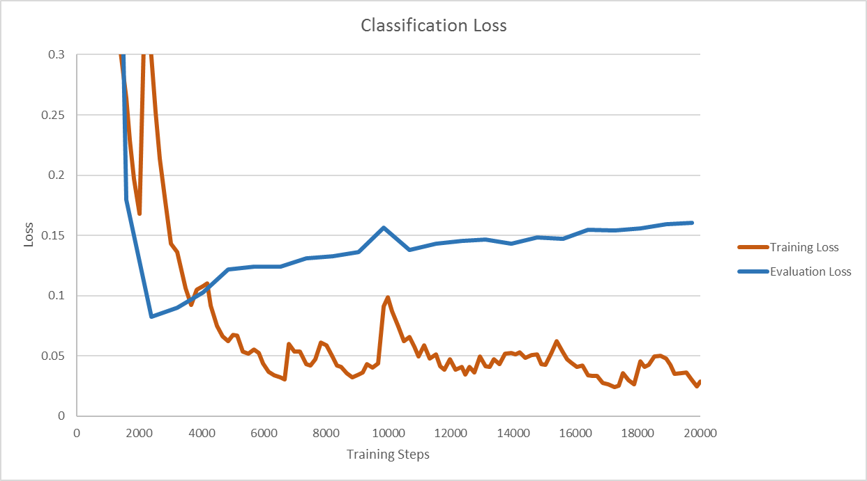
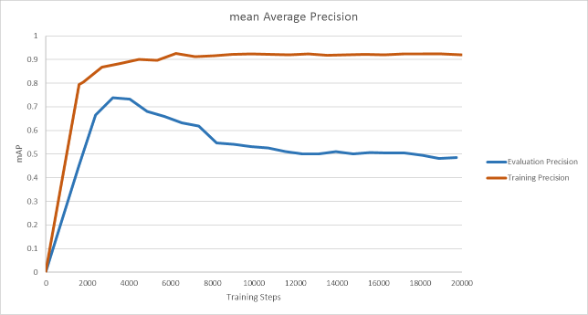
Our Results
Key observations:
Evaluation set reaches optimal values at ~2k steps
Training set performance converges quickly, while evaluation set diverges
What does this mean?
Model is quickly overfitting to training set

Slide 34

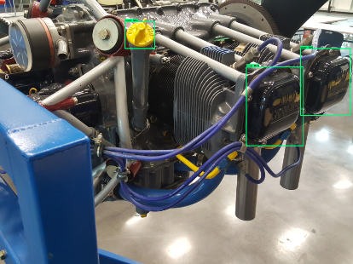





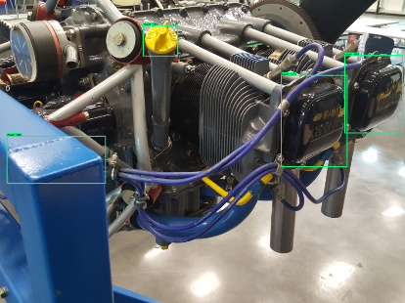





















Our Results
Step 20000
Step 2000
Step 5000
Step 10000
Step 1000
Step 500
Step 0

Slide 35
Object Pose Estimation - 3D case
Larger training set
  ~10k images or more
More diverse training set
  Lighting
  Materials
  Background
  Occlusion
  Color
  Focus
  More negative examples
Other considerations
  More photos for evaluation
  Trying different algorithms and cross training
  Explore data augmentation with random filters, distortion and scaling

Slide 36


Object Pose Estimation - 3D case
6-DOF pose estimation is a much harder problem than 2D bounding boxes
Singleshotpose - new algorithm developed by Microsoft
  Based on the same principle as 2D bounding box estimation
  Instead, train to predict 2D projection of 3D bounding box
Divides the image into a series of boxes, with identified centroids in a box, along with point offsets relative to the centroid (YOLOv2).
Notes:
SingleShotPose – convolutional NN, not R-CNN but YOLO (you only look once). Single-shot framework.
Divide image into series of boxes, centroid in each box, YOLO v2. Since then other better versions of YOLO have been released.
Label files consist of 21 numbers per object in the training image.
9x2+1+C = 21 values. (x,y) positions of the 8 corners and centroid, the class, and the object size in the X and Y directions.

Slide 37

Object Pose Estimation - PnP
Use PnP algorithm to recreate 3D coordinates with respect to camera
3D points can be used in AR procedure assistants

Slide 38






Object Pose Estimation - 3D case
Snubber-cup pose estimation:
  3k synthetic images rendered
  3D bounding boxes and 2D projections automatically generated with Maya
  3D printed model for testing
  Trained slightly modified reference implementation of singleshotpose
Notes:
Bottom are rendered, right are photos. Bottom right is painted and puttied

Slide 39






Object Pose Estimation – Best Results
Notes:
Best results – caveat, not every test image looks like this. Validation script is in a Jupyter notebook. Test.ipymb. SingleShotPose. Wrote another one to

Slide 40






Object Pose Estimation – Worst Results…

Slide 41




Object Pose Estimation - Future Work
Provide clearly defined metric for accuracy
  Planned out workflow for using stickers as ground-truth for future iterations
Gradually add complexity to system
  Realistic background, lighting, partial occlusion, camera noise, etc.
Create pipeline for future use cases
  CAD model as input - trained network as output

Slide 42
Bigger Picture - DML at NASA
Biometric Monitoring
  Pupillometry, EEG, fNIR
  Predict physical and mental health problems
Vehicle Systems Management
  Augmented Reality Procedure Assistants
  Autonomous Surface Vehicles and Navigation
  Mission Control AI

Slide 43
Acknowledgements
Lawrence Hessburg – Graduate Student
Lui Wang – Augmented Reality Expert
Frank Delgado – Advanced Operations Concepts Lab Manager

Slide 44
Questions

